Slide 1
FY20 quality case（Red paper）summary

Slide 2
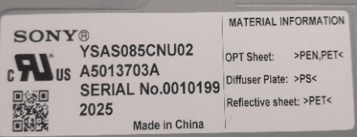
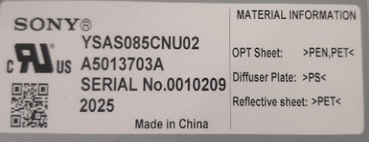
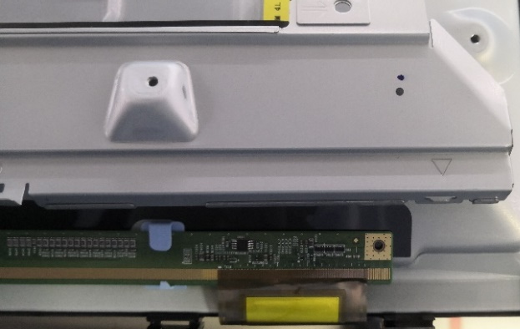
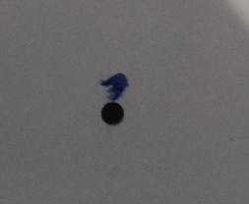
【Market】 20200710/02 --NB85 Gasket missing--SO’EM
Problem Details（不良症状） |  |  |  | Red paper NO. | PIC
Gasket missing |  |  |  | 20200722/1 | Jin
problem Detail |  |  |  | Occurred Date | Quantity
- |  |  |  | 2020/06/21 | 2
Customer Status |  |  |  | FA Date | Parts
During MP production was found in SO’EM production line |  |  |  | 2020/07/22 | P-Mod
S/N NO. | Model | SSV line | shift | Found Plant | Stage
10199/10209 | NB85 module | RC | Night | SOEM | MP
Pictures（写真）
Have marking but no gasket
Gasket attached
Progress Log
Action（改善対策） | Task Progress（内容詳細） | PIC: | Target | Status
1. Define the problem（定义问题） | Gasket missing at one position → right side of source shield(SS) Have marking pen mark from SSV but no Gasket. | SOEM | 7/22 | -
2. Define & verify root cause （真因） | Panel handling rotate on AL-F Assy process. May during handling edge side gasket was touched by hand and dropped. | SSVE制造 | 8/4 | Finish
3. Short-term corrective action （暫定対策） | SOEM Panel Eng add manpower at production line to check gasket at incoming (before input) | SOEM / SSV QA | 7/22 | On going
4. Permanent Corrective Action （恒久対策） | ① Move gasket Assy operation to S-shied Assy process to avoid gasket dropping risk. ② After SS Assy, add inspection for gasket condition before T-con Assy on lay flat condition. Then add “Line” mark on gasket position | SSVE制造 | 8/4 | Finished

Slide 3
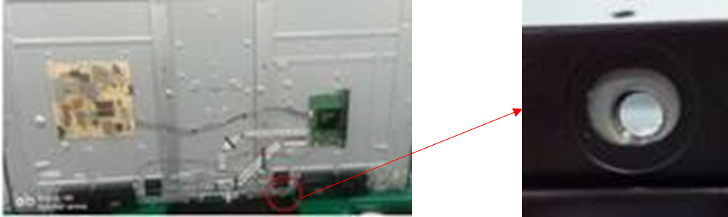

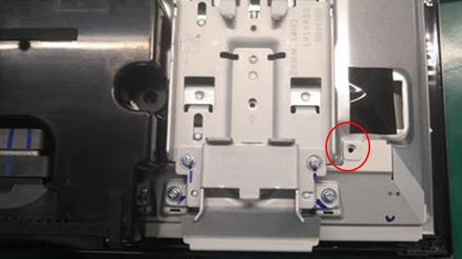

【Market】 20200710/02-- Screw missing issue -SO’EM
Problem Details（不良症状） |  |  |  | Red paper NO. | PIC
Screw missing |  |  |  | 20200710/02 | Jin
problem Detail |  |  |  | Occurred Date | Quantity
- |  |  |  | 2020/07/08 | 2
Customer Status |  |  |  | FA Date | Parts
During MP production was found in SO’EM production line |  |  |  | 2020/07/10 | P-Mod
S/N NO. | Model | SSV line | shift | Found Plant | Stage
8785 / 14613 | NH55 & NB85 Module | M4 & RC | 6/9 夜 / 6/9 白 | SOEM | MP
Pictures（写真）
Progress Log
Action（改善対策） | Task Progress（内容詳細） | PIC: | Target | Status
1. Define the problem（定义问题） | Lately too many issue of screw missing, screw not fully insert, tape missing and etc found in SO’EM production. Almost everyday production make noise for this issue. Almost all size Panel module from SSV have this issue. | SOEM | 7/10 | -
2. Define & verify root cause （真因） |  | SSVE制造 |  | On going
3. Short-term corrective action （暫定対策）
4. Permanent Corrective Action （恒久対策）

Slide 4
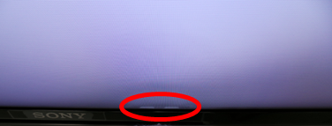
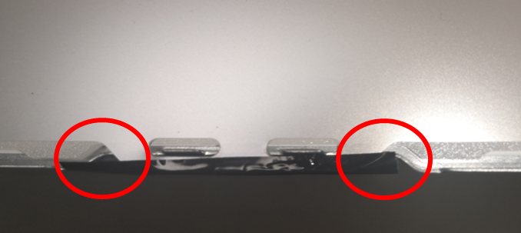
【Market】 20200709/01-- Sheet wrinkle issue - FSK
Problem Details（不良症状） |  |  |  | Red paper NO. | PIC
Sheet wrinkle |  |  |  | 20200709/01 | Jin
problem Detail |  |  |  | Occurred Date | Quantity
- |  |  |  | 2020/07/08 | 3
Customer Status |  |  |  | FA Date | Parts
During MP production was found in FSK production line |  |  |  | 2020/07/09 | P-Mod
S/N NO. | Model | SSV line | shift | Found Plant | Stage
3391/3399/3413 | NH65 Module | M4 | 1/18 夜 | SOEM | MP
Pictures（写真）
A5013677A$0003391_2003-YDAS065DNU02
A5013677A$0003399_2003-YDAS065DNU02
A5013677A$0003413_2003-YDAS065DNU02
Progress Log
Action（改善対策） | Task Progress（内容詳細） | PIC: | Target | Status
1. Define the problem（定义问题） | On I8 position FSK operator detected NG panel with symptom -Wrinkled sheet. After open panel we found incorrect sticking of black tape, which fixing optical sheets. All 3 NG panels have same problem. | FSK | 7/9 | -
2. Define & verify root cause （真因） | Operation mistake | SSVE制造 | 7/24 | Finish
3. Short-term corrective action （暫定対策） | - | - | - | -
4. Permanent Corrective Action （恒久対策） | Add inspection before MC assy for fix tape condtion | SSVE制造 | 7/24 | Finish

Slide 5
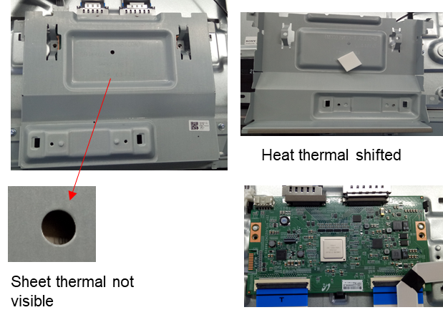
【Market】 20200710/01– Heat thermal missing - SOEM
Problem Details（不良症状） |  |  |  | Red paper NO. | PIC
Heat thermal missing |  |  |  | 20200710/01 | Jin
problem Detail |  |  |  | Occurred Date | Quantity
- |  |  |  | 2020/07/22 | 2
Customer Status |  |  |  | FA Date | Parts
During MP production was found in SOEM production line |  |  |  | 2020/07/22 | P-Mod
S/N NO. | Model | SSV line | shift | Found Plant | Stage
920 / 915 | NX75 | M3 | 3/29 白 | SOEM | MP
Pictures（写真）
Progress Log
Action（改善対策） | Task Progress（内容詳細） | PIC: | Target | Status
1. Define the problem（定义问题） | Heat thermal is not visible from T-con cover hole. Defect ratio: 2 / 160 = 1.25% - After dissasy T-con cover, found sheet thermal attached to T-con cover board in shifted condition - No mark on T-con IC | FSK | 7/9 | -
2. Define & verify root cause （真因） | Suspect root cause that thermal pad stick mistake | SSVE制造 | 7/17 | Finish
3. Short-term corrective action （暫定対策） | - | - | - | -
4. Permanent Corrective Action （恒久対策） | 1. Make clear the Heat thermal stick position on T-con IC that must cover all T-con IC. 2. Enhancing the inward inspection that make notice that thermal half visible condition is also NG. Then added pen mark after inspection | SSVE制造 | 7/17 | Finish

Slide 6
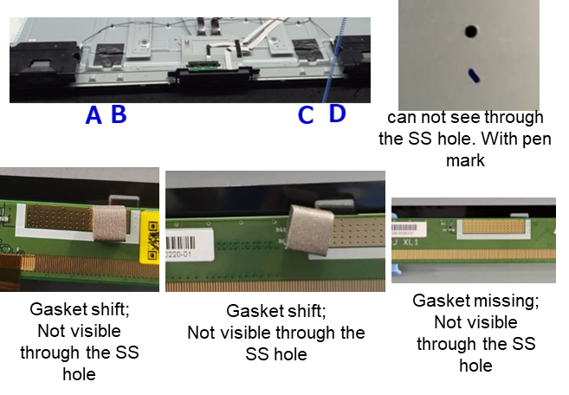
【Market】 20200804/01 --NX85 Gasket missing--SO’EM
Problem Details（不良症状） |  |  |  | Red paper NO. | PIC
Gasket missing |  |  |  | 20200804/01 | Jin
problem Detail |  |  |  | Occurred Date | Quantity
- |  |  |  | 2020/08/04 | 4
Customer Status |  |  |  | FA Date | Parts
During MP production was found in SO’EM production line |  |  |  | 2020/08/04 | P-Mod
S/N NO. | Model | SSV line | shift | Found Plant | Stage
4219/4221/4224/4106 | NX85 | RC | 6/3 白 | SOEM | MP
Pictures（写真）
Progress Log
Action（改善対策） | Task Progress（内容詳細） | PIC: | Target | Status
1. Define the problem（定义问题） | Inwards detected gasket is not visible through the SS hole for 85QX Total result as below: Gasket shifted: 3/230pcs Location: 2pcs at B area, 1pc at C area Gasket missing: 1/230pcs Location: A area | SOEM | 7/22 | -
2. Define & verify root cause （真因）
3. Short-term corrective action （暫定対策）
4. Permanent Corrective Action （恒久対策）

